Slide 1
CT4029 Principles of Programming Day 1 – Session 2 Control Structures : Loops, Switches, and Conditions

Slide 2
Learning Outcomes
Using loops for multiple iterations
for Loop
While Loop
Using statements to satisfy instructions and alternative instructions
if
if/else
if/elif…/else
Continue
Break
Pass

Slide 3
Today’s Agenda!
Repetition statements
for … range loops
Cumulative loops
Nested loops
While loops
Condition statements
Logical operators and expressions

Slide 4
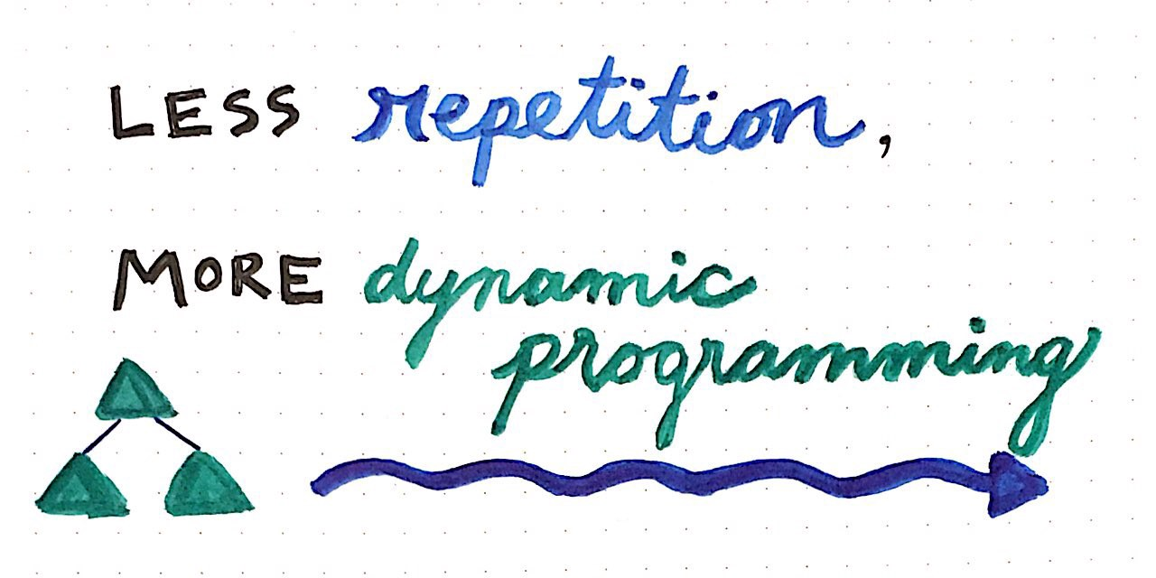
Repetition Statements

Slide 5
What is Loop in Programming?
A loop, in programming, is a series of instructions that is repeated until a specific condition is satisfied. Specifically, a certain process is completed, such as getting a data item and changing it while checking that the counter has reached a defined number.
In Python, all the statements indented by the same number of character spaces after a programming construct are considered to be part of a single block of code. Python uses indentation as its method of grouping statements.

Slide 6
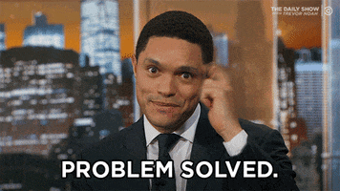
Loops will save you time and Resources!
For example: print the first 10 multiples of 6 (without loops)
print (6*1)
print (6*2)
print (6*3)
print (6*4)
print (6*5)
print (6*6)
print (6*7)
print (6*8)
print (6*9)
print (6*10)
for x in range(1, 11):
print (6 * x)

Slide 7
The for loop: general syntax
for loop: Repeats a set of statements over a group of values.
Syntax:
for variableName in groupOfValues:
statements
We indent the statements to be repeated with tabs or spaces.
variableName gives a name to each value, so you can refer to it in the statements.
groupOfValues can be a range of integers, specified with the range function.
Example:
for x in range(1, 6):
print (x, "squared is", x * x)
Output:
1 squared is 1
2 squared is 4
3 squared is 9
4 squared is 16
5 squared is 25

Slide 8
The for loop: range
The range function specifies a range of integers:
range(start, stop) - the integers between start (inclusive) and stop (exclusive)
It can also accept a third value specifying the change between values.
range(start, stop, step) - the integers between start (inclusive) and stop (exclusive) by step
Example:
for x in range(5, 0, -1):
print(x)
print ("Blastoff!“)
Output:
5
4
3
2
1
Blastoff!
Exercise: print the nursery rhyme “There were 10 in the bed and the little one said roll over” using for loop

Slide 9
Cumulative loops
Some loops incrementally compute a value that is initialized outside the loop. This is sometimes called a cumulative sum.
sum = 0
for i in range(1, 11):
sum = sum + (i * i)
print (“sum of first 10 squares is", sum)
Output:
sum of first 10 squares is 385

Slide 10
Nested Loops
As the name suggest, nested loop is simply a loop inside another loop.
This means, having a loop (let's call it outer loop) that has inside its commands another loop (let's call it inner loop).

Slide 11
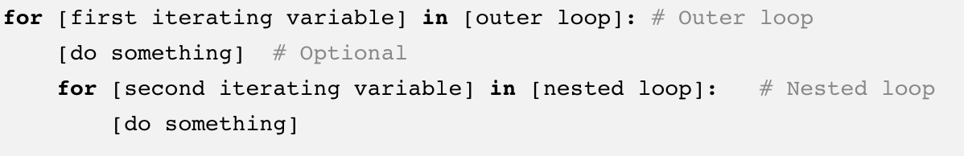
Nested Loops – contd.
The syntactical structure of a Nested for loop is:

Slide 12
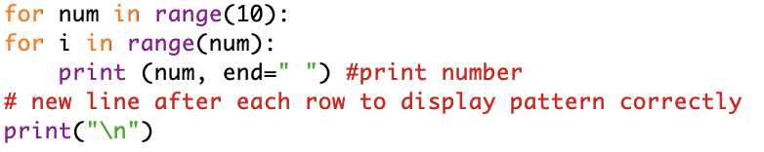
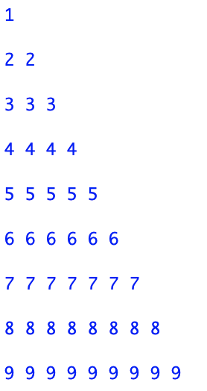
Nested Loops - Example

Slide 13
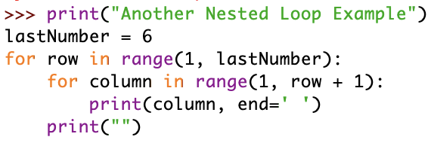
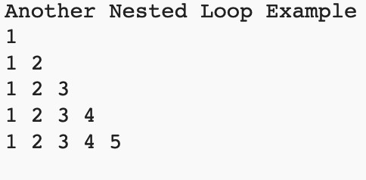
Nested Loops – Example 2

Slide 14
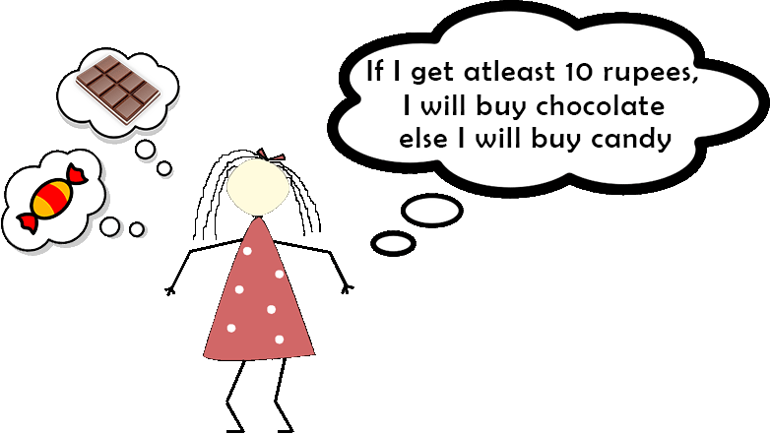
Condition Statements

Slide 15
What is Condition statement in Programming?
Conditional expressions and conditional constructs are features of a programming language, which perform different computations or actions depending on whether a programmer-specified Boolean condition evaluates to true or false.

Slide 16
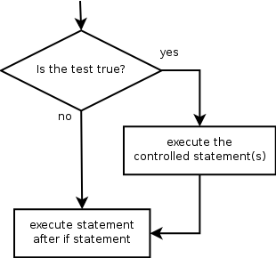
if statement
if statement: Executes a group of statements only if a certain condition is true. Otherwise, the statements are skipped.
Syntax:
if condition:
statements
Example:
gpa = 3.4
if gpa > 2.0:
print ("Your application is accepted.”)

Slide 17
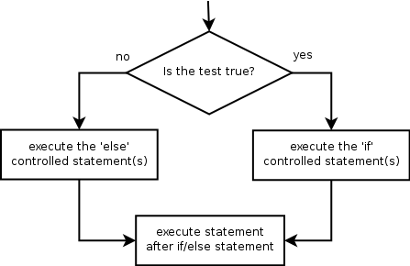
if/else statement
if/else statement: Executes one block of statements if a certain condition is True, and a second block of statements if it is False.
Syntax:
if condition:
statements
else:
statements
Example:
gpa = 1.4
if gpa > 2.0:
print ("Welcome to Mars University!“)
else:
print ("Your application is denied.“)

Slide 18
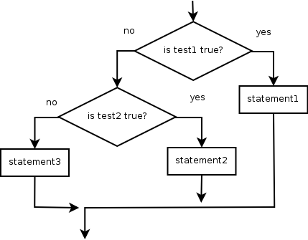
if/elif/else (1/2)
Multiple conditions can be chained with elif ("else if"):
Syntax:
if condition:
statements
elif condition:
statements
else:
statements

Slide 19
if/elif/else (2/2)
Example:
staffid = 123
if staffid == 333:
print ("Welcome to the Vault!")
elif staffid == 321:
print ("Welcome to the Vault!")
elif staffid == 345:
print ("Welcome to the Vault!")
else:
print("see ya later!!!")
Output ?

Slide 20
“Continue” Statement (1/2)
The continue statement gives you the option to skip over the part of a loop where an external condition is triggered, but to go on to complete the rest of the loop. That is, the current iteration of the loop will be disrupted, but the program will return to the top of the loop.
The continue statement will be within the block of code under the loop statement, usually after a conditional if statement.

Slide 21
“Continue” Statement (2/2)
The continue statement can stop the current iteration of the loop, and continue with the next
for val in "string":
if val == "i":
continue
print(val)
print("The end")
Output?

Slide 22
“Break” Statement (1/2)
In Python, the break statement provides you with the opportunity to exit out of a loop when an external condition is triggered. You’ll put the break statement within the block of code under your loop statement, usually after a conditional if statement.
Let’s look at an example that uses the break statement in a for loop:

Slide 23
“Break” Statement (2/2)
for val in "string":
if val == "i":
break
print(val)
print(val)
print("The end")
Output:
s
t
r
i
The end

Slide 24
“Pass” Statement (1/2)
Python has the syntactical requirement that code blocks (after if, except, def, class etc.) cannot be empty. Empty code blocks are however useful in many different contexts
When an external condition is triggered, the pass statement allows you to handle the condition without the loop being impacted in any way; all of the code will continue to be read unless a break or other statement occurs.
As with the other statements, the pass statement will be within the block of code under the loop statement, typically after a conditional if statement.

Slide 25
“Pass” Statement (2/2)
number = 0
for number in range(10):
number = number + 1
if number == 5:
pass # pass here
print('Number is ' + str(number))
print('Out of loop')
Output?

Slide 26
while Loop (1/3)
A while loop statement in Python programming language repeatedly executes a target statement as long as a given condition is true.
When the condition becomes false, program control passes to the line immediately following the loop.

Slide 27
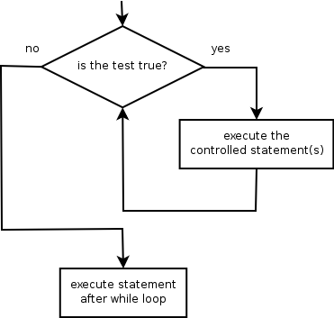
while Loop (2/3)
while loop: Executes a group of statements as long as a condition is True.
good for indefinite loops (repeat an unknown number of times)
Syntax:
while condition:
statements
Example:
number = 1
while number < 200:
print (number)
number = number * 2
Output:
1 2 4 8 16 32 64 128

Slide 28
while Loop (3/3)
count = 0
while (count < 9):
print ("The count is:", count)
count = count + 1
print ("Good bye!")
Output?

Slide 29
Logic operators and expressions
Many logical expressions use relational operators:
Logical expressions can be combined with logical operators.
Operator | Meaning | Example | Result
== | equals | 1 + 1 == 2 | True
!= | does not equal | 3.2 != 2.5 | True
< | less than | 10 < 5 | False
> | greater than | 10 > 5 | True
<= | less than or equal to | 126 <= 100 | False
>= | greater than or equal to | 5.0 >= 5.0 | True
Operator | Example | Result
and | 9 != 6 and 2 < 3 | True
or | 2 == 3 or -1 < 5 | True
not | not 7 > 0 | False

Slide 30
Next Session!
Passing values
Code reusability
Functions
Parameters and arguments

Slide 31
